Slide 1
Oregon eWIC Showcase Data & Reports Program Integrity & Compliance
Portland, OR
March 22, 2017

Slide 3
Issuance Data Sent from MIS
Household ID
Agency and Clinic
Benefit Month
Benefit Start and End Dates
Category
Subcategory
Quantities

Slide 4
Redemption Data from Transactions
Date and Time
Vendor Demographics, Peer Group
Category, Subcategory, Quantities Purchased
Prices, NTEs, Discounts
Card Number
Household ID

Slide 5
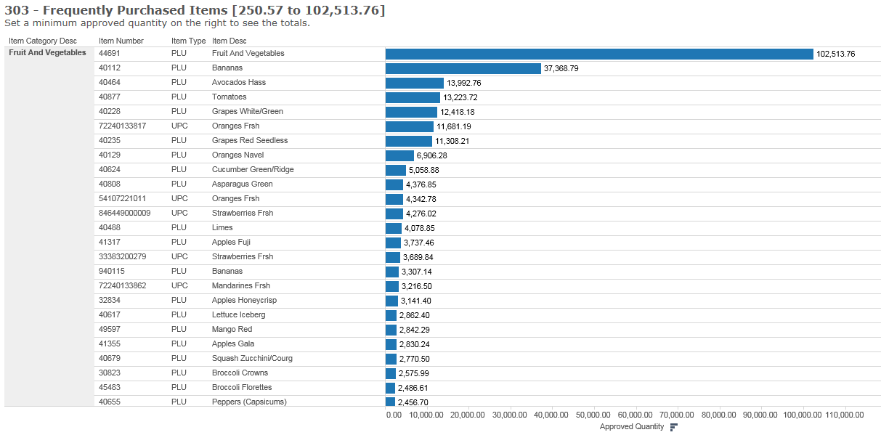

Slide 6
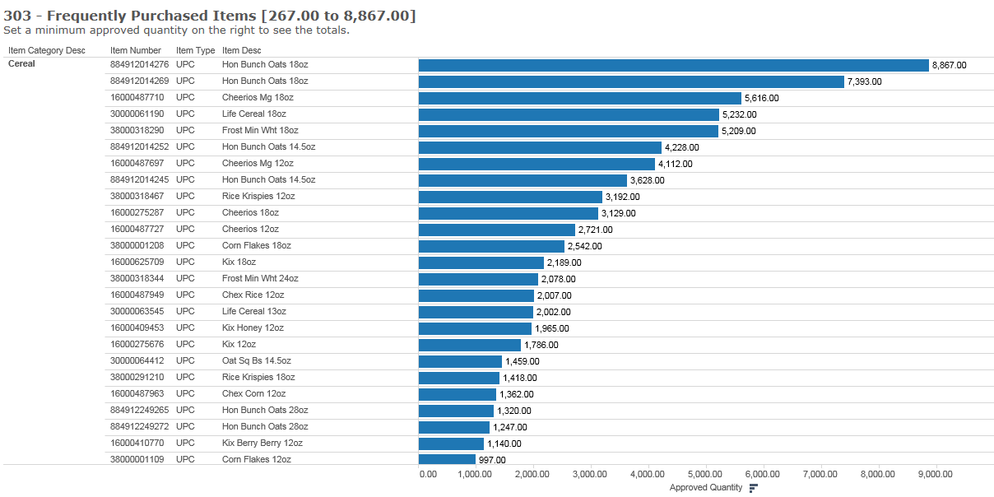

Slide 7
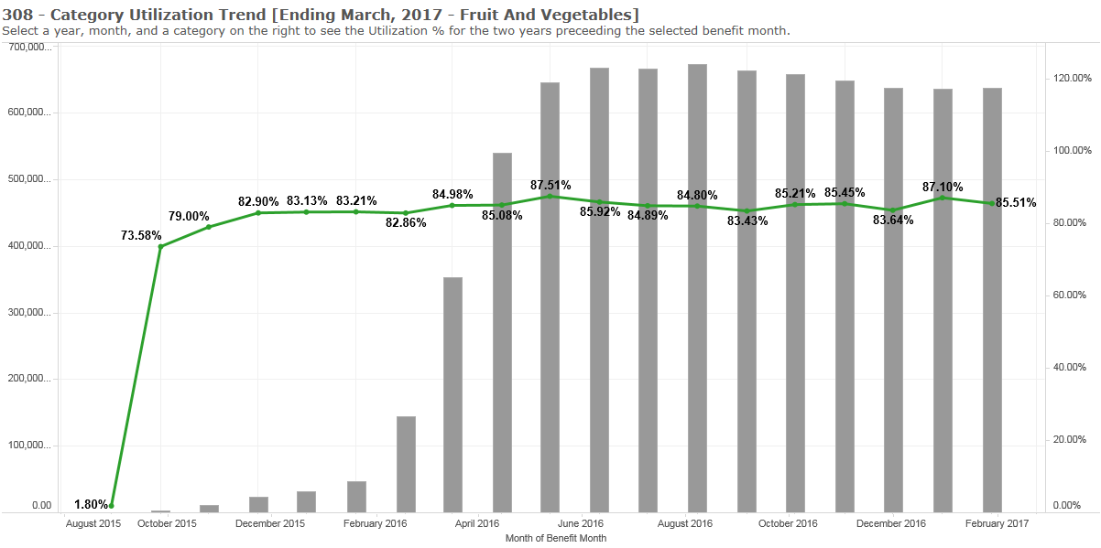

Slide 8
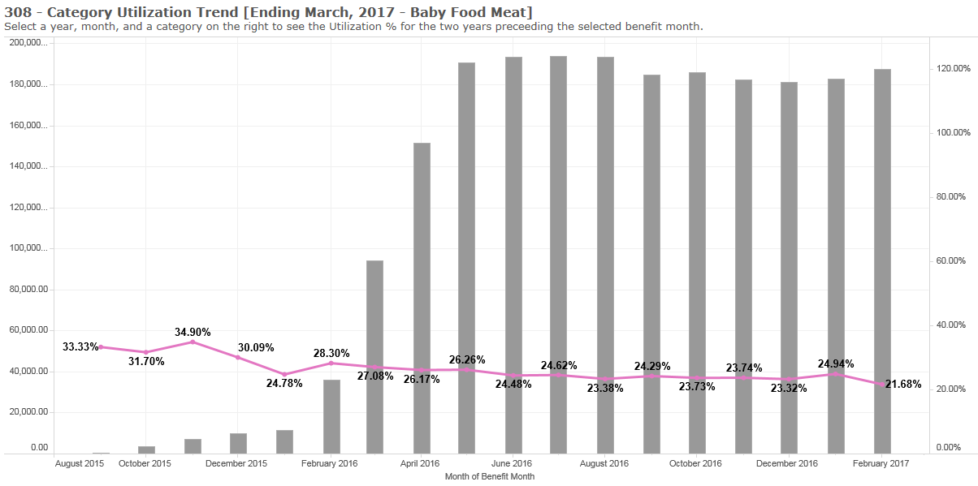

Slide 9
Quarterly Redemption Report
Posted on our website
Includes:
UPC
Category
Subcategory
Item short description
Item long description
Quantity purchased

Slide 10
Quarterly Redemption Report
Does not include fruit and vegetables
Many stores are still just partial mapping (using the generic 4469 code)
Full mapping is ideal, where UPC-packaged fruits and vegetables are mapped to specific PLUs

Slide 11
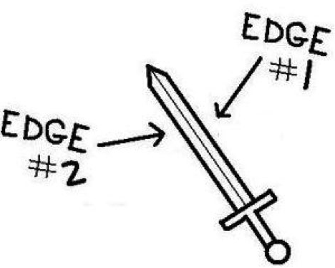
PLU Mapping
Great for participants – items scan
Great for the state – detailed data
However, it prevents manufacturers with UPC-packaged fruits and vegetables from getting accurate data

Slide 12
Common Ad Hoc Reports
Popular sizes purchased
Most expensive items
Issuance of specialty items (e.g, milks, formulas)
Redemptions by region, county
Troubleshooting for shoppers – which stores in county X have redemptions for product Y?

Slide 14
REQUESTED AMOUNT
(what the store charges for the item)

Slide 15
REQUESTED AMOUNT
(what the store charges for the item)
Subtract NTE adjustment

Slide 16
REQUESTED AMOUNT
(what the store charges for the item)
Subtract NTE adjustment
PAID AMOUNT

Slide 17
REQUESTED AMOUNT
(what the store charges for the item)
Subtract NTE adjustment
PAID AMOUNT
Subtract Discounts/Coupons

Slide 18
REQUESTED AMOUNT
(what the store charges for the item)
Subtract NTE adjustment
PAID AMOUNT
Subtract Discounts/Coupons
SETTLEMENT AMOUNT

Slide 19
eWIC Data and Program Integrity
Competitive Pricing
Complaints
High Risk Analysis
Investigations

Slide 20
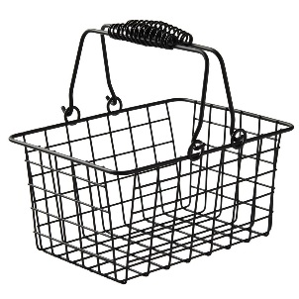
Competitive Pricing
Use eWIC data to compare store prices to peer group prices.
Market Basket: Baby food, whole grains, cereal, cheese, eggs, bid formula, juice, low-fat milk, peanut butter, whole milk.
Monitor compliance via mid-contract assessment and routine monitorings

Slide 21
Complaints
Increase in complaints about stores not allowing certain foods.
Use eWIC data to research transactions and determine next steps.

Slide 22
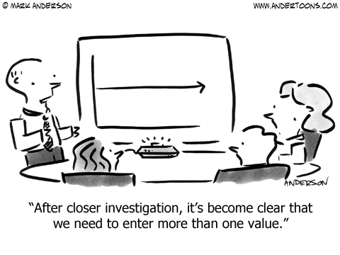
High Risk
Transition until adequate volume of eWIC data
Redemption Amount: High mean, low variance
Foods: Category volume/mix
Transaction: Key vs swipe, time/day
System: Integrated vs. stand beside POS

Slide 23
Investigations
Transition timeline for compliance activities
Voucher vs. eWIC investigations
Learning curve and allowing time to work out bugs
Use average account balances
Faster investigation set-up & completion time
Few substitutions, explore mixed basket buys
Inventory audit accuracy

Slide 24
Questions?
Kim Word
eWIC Project Manager
kimberly.m.word@state.or.us
971-673-0069
Jazette Johnson
Compliance Coordinator
jazette.johnson@state.or.us
971-673-0061

