Slide 1
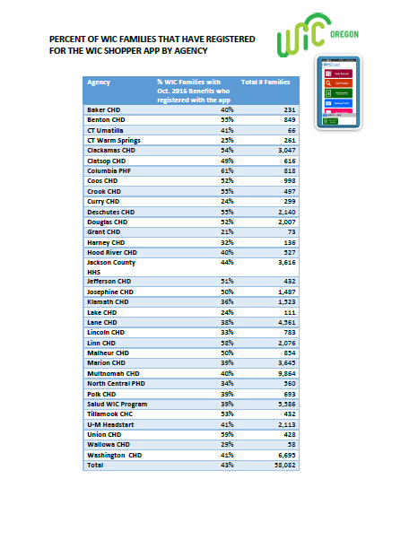
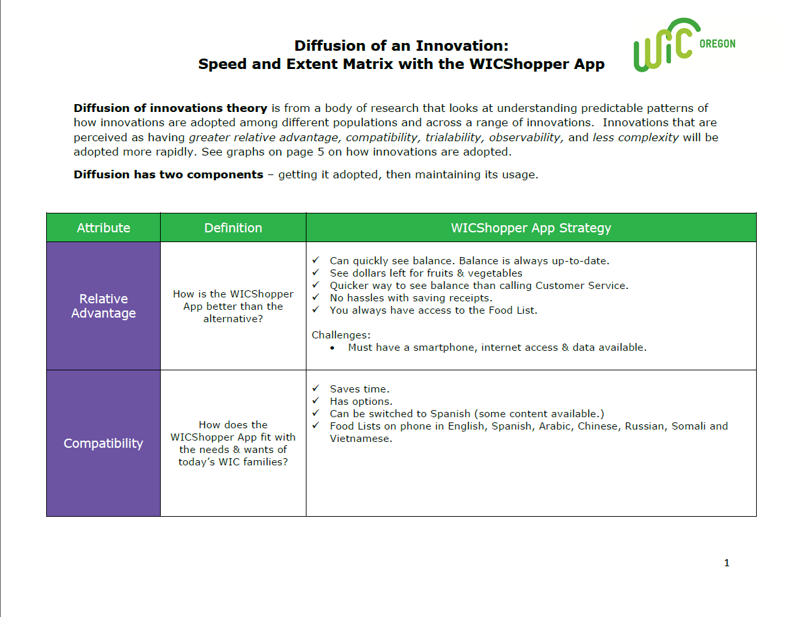
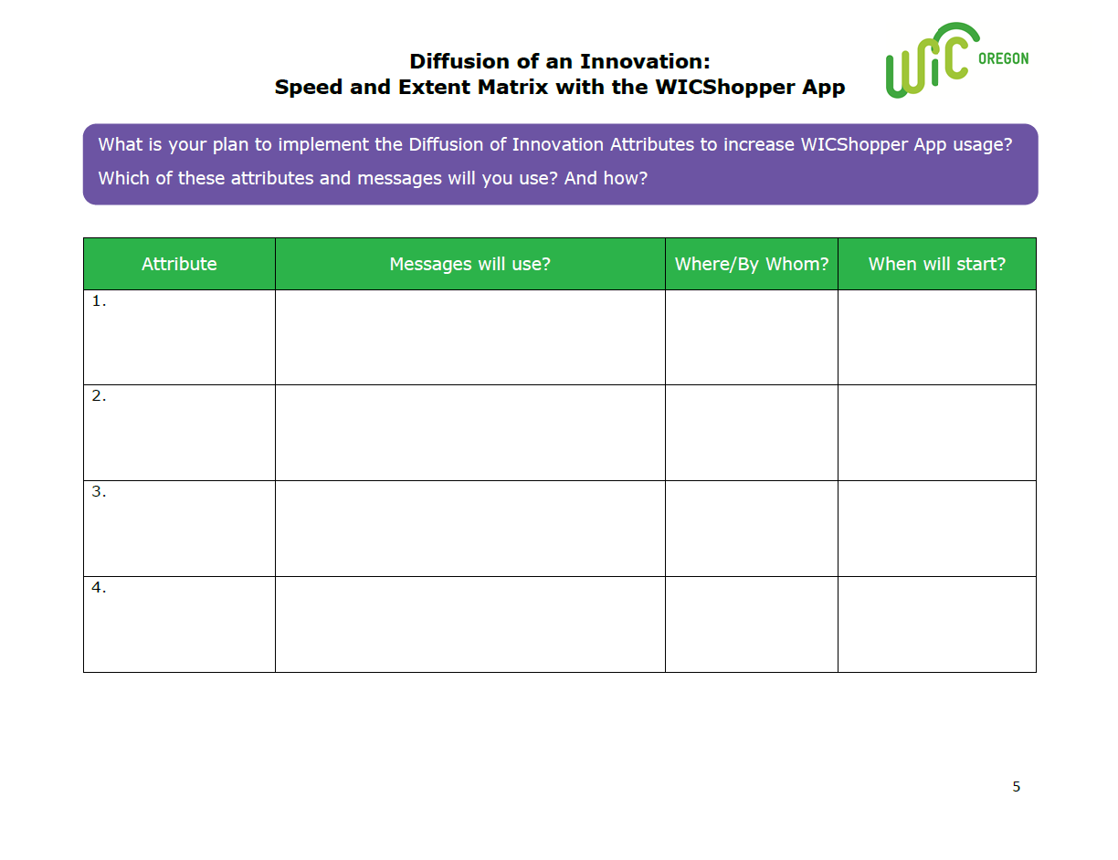
This video in-service (approx. 30 min.) provides an update on how far we’ve gotten with participants downloading and using the WICShopper App.
To reach more families, we turn to the Diffusion of Innovation theory for proven strategies and highlight staff from Multnomah Co. and Linn Co. who are already using these strategies.
Staff in-service April 2017 – Part 2
The video in-service link is on the next slide. Speakers will be needed.
Handouts referred to during in-service.
Bonus tracks include a full version of Igor Chevtchenko’s report and a report by Yami Garcia, Clatsop Co.

Slide 2
https://youtu.be/Lbs8wNY56MU

Slide 3
Bonus Track
Full-length report by Igor Chevtchenko
Multnomah County
(16:23)
Click here to play

Slide 4
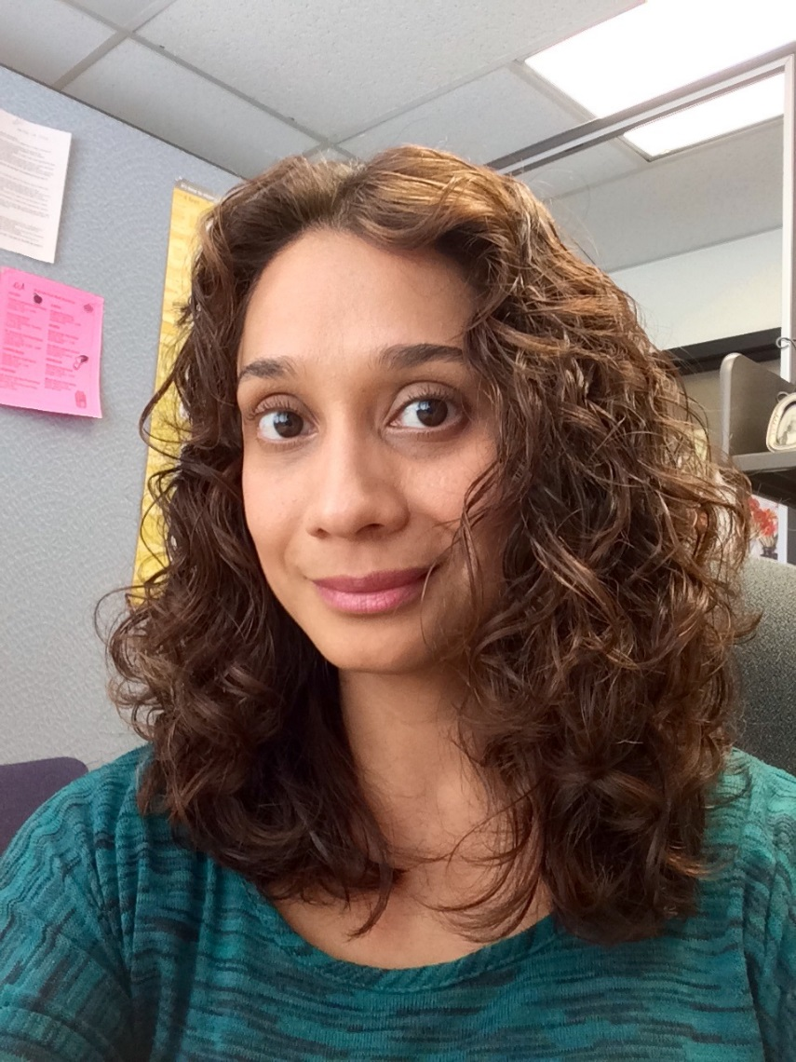
Bonus Track
Full-length report by Yami Garcia
Clatsop County
(1:05)
Click here to play

